Slide 1

WELCOME

Slide 2
Introduction
RUVELMOLLAH
Assistant teacher
Rampur High School
Kapasia , Gazipur.
Class- Eight
Subject-English 1st paper
Time-50 minutes
Date:15-02-2014

Slide 3
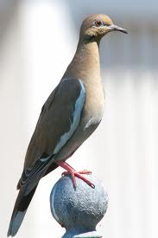
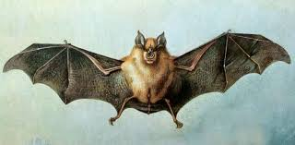

Slide 4
‘The truthful dove’
Unit-5,lesson-5, page-60
NAME OF LESSON

Slide 5
Learning out comes
After studied the lesson the students will be able to
speak the dissimilarity of dove and bat.
explain the action of dove and bat .
describe the owl ,bat and dove’s character .

Slide 6
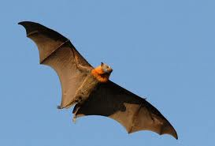
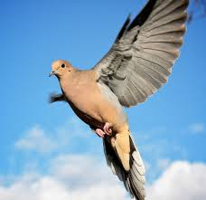
Individual Work
Read the text silently and answer the questions .(orally )
1.Who were very good friends ?
2. Who decided to set out on a journey ?
3. Who was grumpy ?

Slide 7
Individual work
Read the text again and make sentences from the table.
The dove and bat They | Decided were | Very tired. to fly over rivers and hills. To look for a shelter. Very good friends.

Slide 8
Pair work
Write ten sentence ,What is the dissimilarity of bat and dove ?

Slide 9
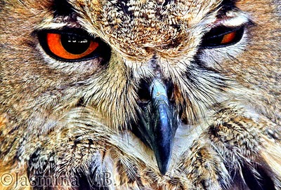
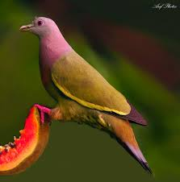
Group Work
Comparatively who was good at heart and Why ?

Slide 10
Evaluation
True or false ? If false give the correct information .
1.The dove and the bat decided to go for a flying competition .
2.They reached a big jungle .
3.They were afraid because a storm was blowing .
4.The dove and the bat were looking for a place to spend the night .
5.The owl gladly asked the bat and the dove to come in.
6.The owl and the birds at together.
7. The bat sincerely praised the owl .

Slide 11
Home task
Write a paragraph using your own words about cuckoo and crow on basis of task .

Slide 12

THANKS

